Slide 1
Conjugate Gradient
Section 10.8 of Numerical Recipes (3rd ed.)

Slide 2
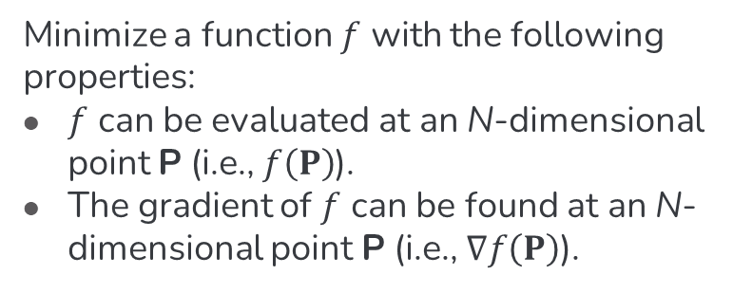
Objective
Minimize a function $f$ with the following properties:
$f$ can be evaluated at an N-dimensional point P (i.e., $f\left(P\right)$).
The gradient of $f$ can be found at an N-dimensional point P (i.e., $∇f\left(P\right)$).

Slide 3
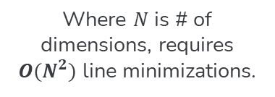
First Intuitive Solution
Line Methods
Characteristics
(i.e. Powell’s Method)
Where $N$ is # of dimensions, requires $O(N^{2})$ line minimizations.

Slide 4
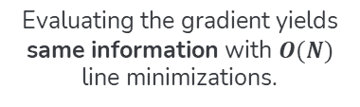
First Intuitive Solution
Line Methods
Characteristics
Problem
(i.e. Powell’s Method)
Where $N$ is # of dimensions, requires $O(N^{2})$ line minimizations.
Evaluating the gradient yields same information with $O(N)$ line minimizations.

Slide 5
First Intuitive Solution
Line Methods
Characteristics
Problem
Problem*
(i.e. Powell’s Method)
Where $N$ is # of dimensions, requires $O(N^{2})$ line minimizations.
Evaluating the gradient yields same information with $O(N)$ line minimizations.
*Calculating each component of the gradient may take as long as evaluating the function itself, meaning the order of function evaluations may be the same. Even in that case, methods which use the gradient are substantially less computationally expensive.

Slide 6
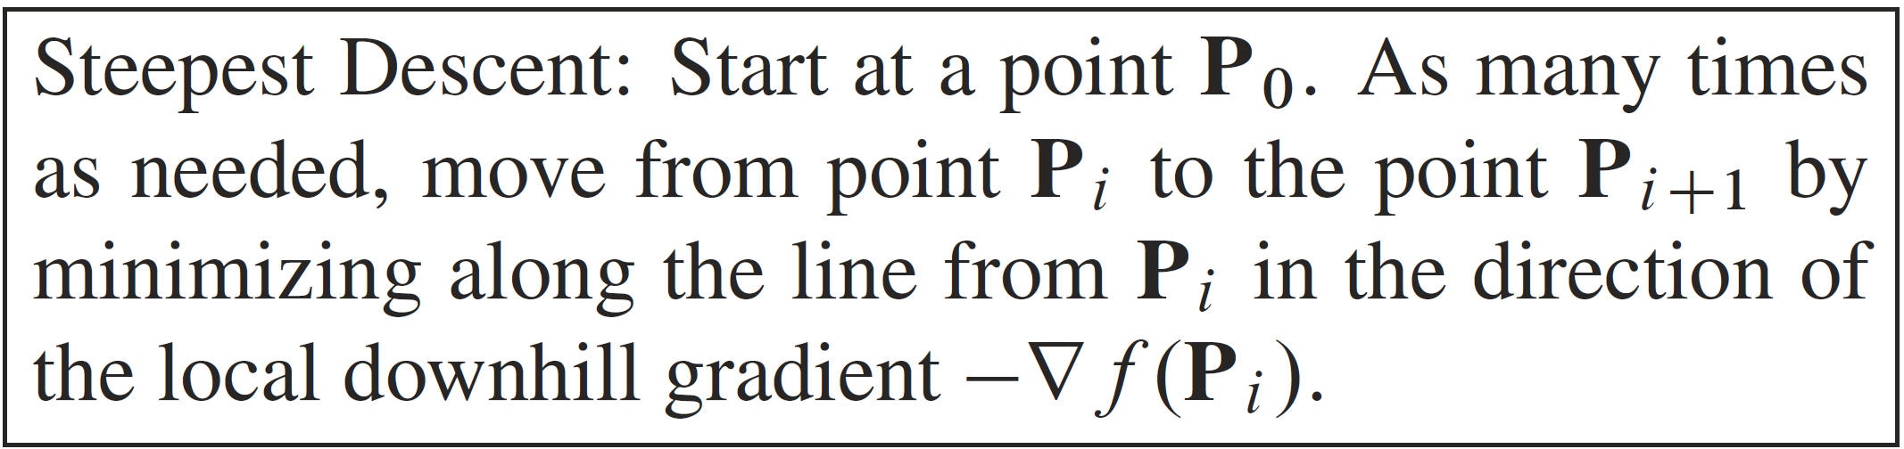
Second Intuitive Solution

Slide 7
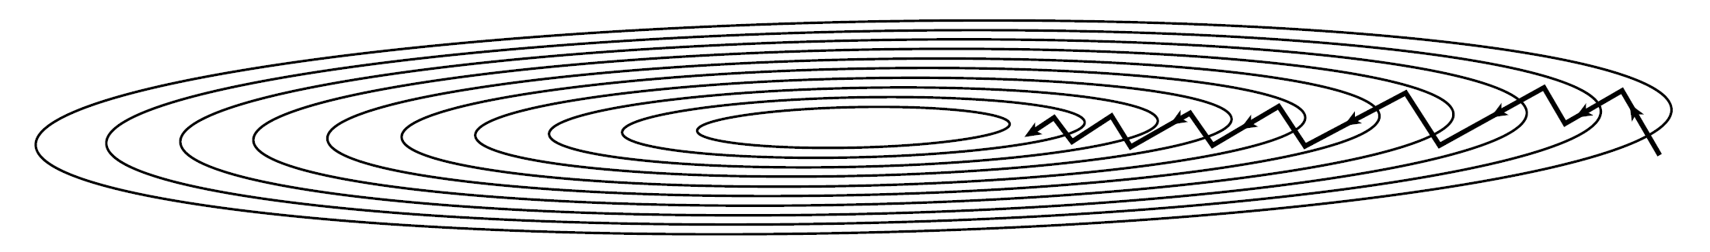
Second Intuitive Solution
Problem
“the new gradient at the minimum point of any line minimization is perpendicular to the direction just traversed. Therefore, with the steepest descent method, you must make a right angle turn, which does not, in general, take you to the minimum.”

Slide 8
The Big Idea
Conjugate Directions!

Slide 9
Defining Informally
“’noninterfering’ directions with the special property that minimization along one is not ‘spoiled’ by subsequent minimization along another”
Informal definition from section 10.7

Slide 10
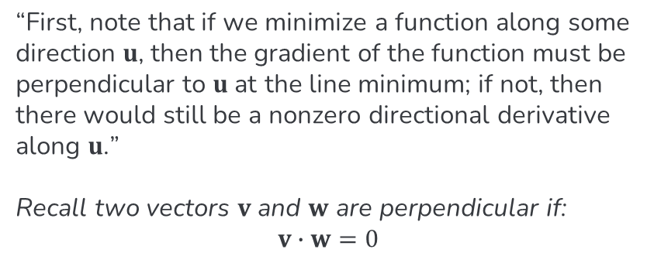
Starting Note
“First, note that if we minimize a function along some direction $u$, then the gradient of the function must be perpendicular to $u$ at the line minimum; if not, then there would still be a nonzero directional derivative along $u$.”
Recall two vectors $v$ and $w$ are perpendicular if: $$v∙w=0$$
From section 10.7.1

Slide 11
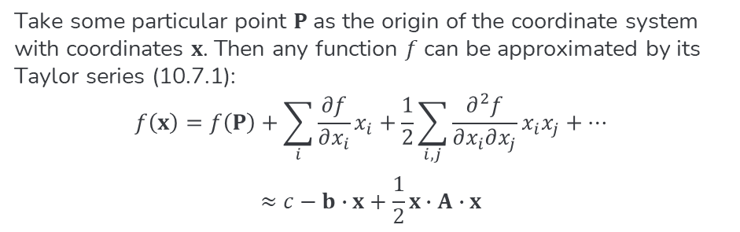
Quadratic Forms
Take some particular point $P$ as the origin of the coordinate system with coordinates $x$. Then any function $f$ can be approximated by its Taylor series (10.7.1):
$$f\left(x\right)=f\left(P\right)+\sum_{i}{\frac{∂f}{∂x_{i}}x_{i}}+\frac{1}{2}\sum_{i,j}{\frac{∂^{2}f}{∂x_{i}∂x_{j}}x_{i}x_{j}}+…$$
$$≈c−b∙x+\frac{1}{2}x∙A∙x$$

Slide 12
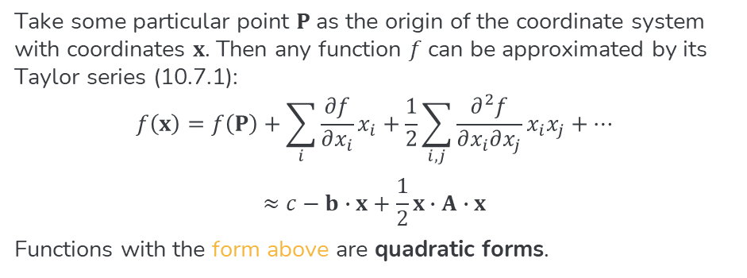
Quadratic Forms
Take some particular point $P$ as the origin of the coordinate system with coordinates $x$. Then any function $f$ can be approximated by its Taylor series (10.7.1):
$$f\left(x\right)=f\left(P\right)+\sum_{i}{\frac{∂f}{∂x_{i}}x_{i}}+\frac{1}{2}\sum_{i,j}{\frac{∂^{2}f}{∂x_{i}∂x_{j}}x_{i}x_{j}}+…$$
$$≈c−b∙x+\frac{1}{2}x∙A∙x$$
Functions with the form above are quadratic forms.

Slide 13
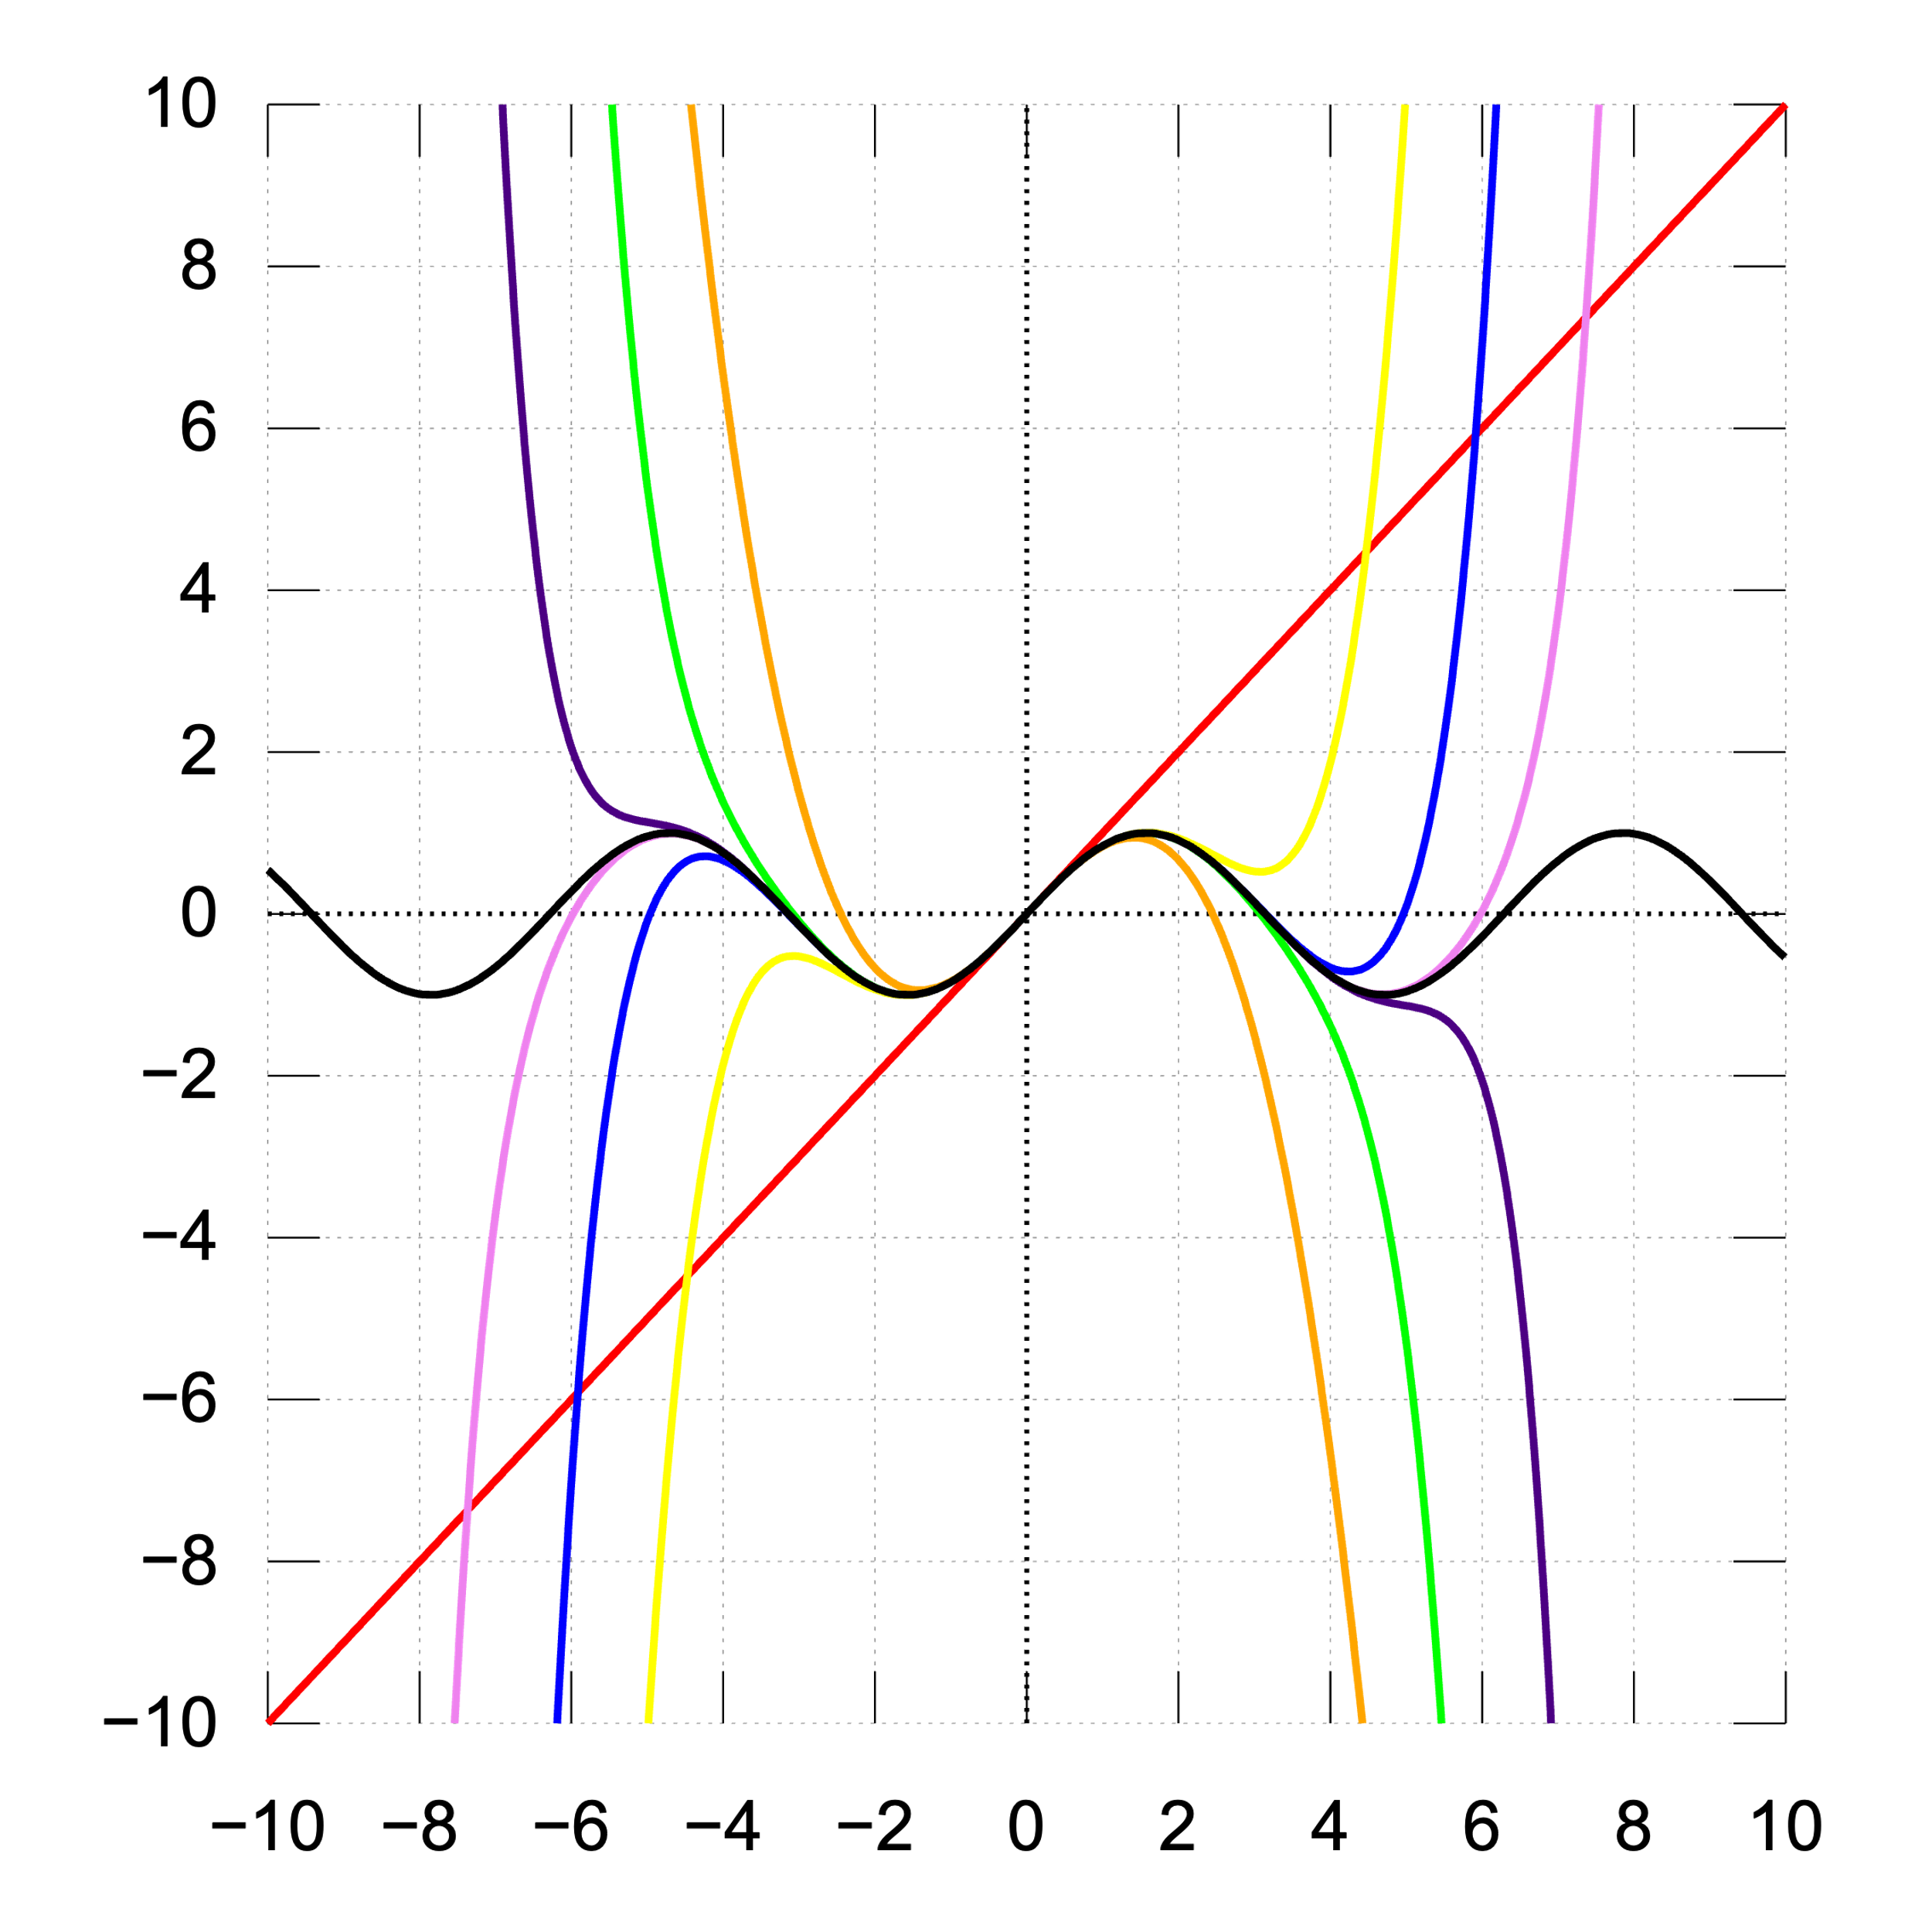
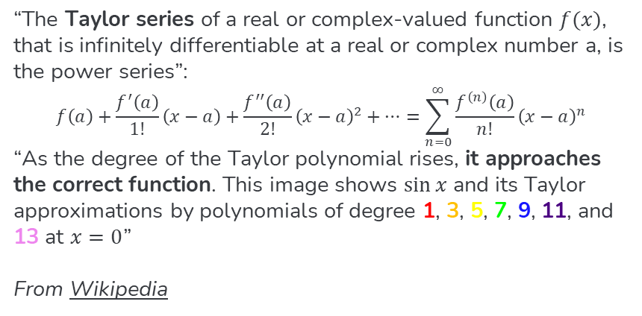
Taylor Series Review
“The Taylor series of a real or complex-valued function $f(x)$, that is infinitely differentiable at a real or complex number a, is the power series”:
$$f\left(a\right)+\frac{f^{′}\left(a\right)}{1!}\left(x−a\right)+\frac{f^{′′}\left(a\right)}{2!}{\left(x−a\right)}^{2}+…=\sum_{n=0}^{∞}{\frac{f^{\left(n\right)}\left(a\right)}{n!}{\left(x−a\right)}^{n}}$$
“As the degree of the Taylor polynomial rises, it approaches the correct function. This image shows $\sin{x}$ and its Taylor approximations by polynomials of degree 1, 3, 5, 7, 9, 11, and 13 at $x=0$”
From Wikipedia
By IkamusumeFan - Own work, CC BY-SA 3.0, https://commons.wikimedia.org/w/index.php?curid=27865201

Slide 14
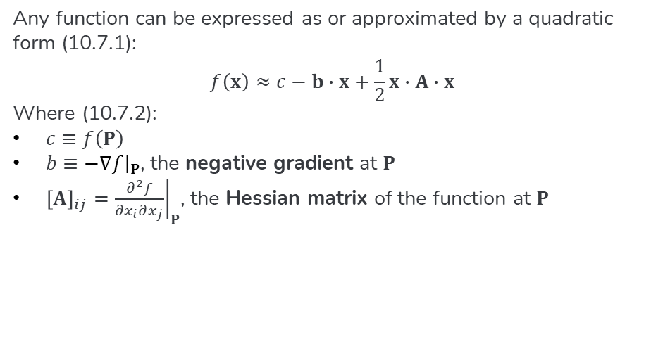
Quadratic Forms
Any function can be expressed as or approximated by a quadratic form (10.7.1):
$$f\left(x\right)≈c−b∙x+\frac{1}{2}x∙A∙x$$
Where (10.7.2):
$c≡f\left(P\right)$
$b≡{\left.−∇f\right|}_{P}$, the negative gradient at $P$
${\left[A\right]}_{ij}={\left.\frac{∂^{2}f}{∂x_{i}∂x_{j}}\right|}_{P}$, the Hessian matrix of the function at $P$

Slide 15
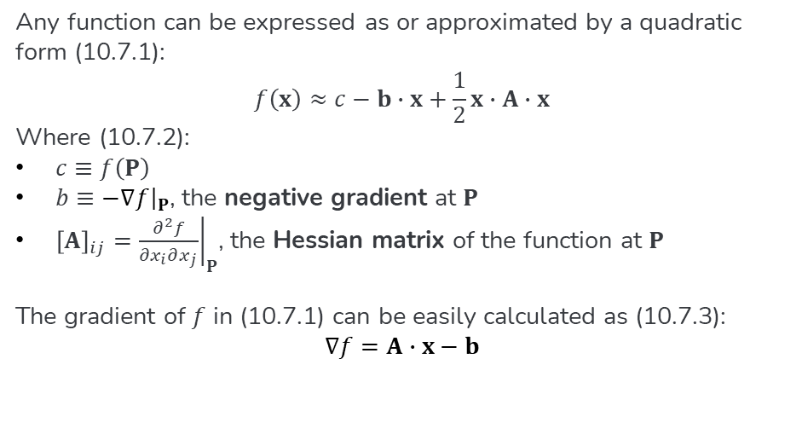
Quadratic Forms
Any function can be expressed as or approximated by a quadratic form (10.7.1):
$$f\left(x\right)≈c−b∙x+\frac{1}{2}x∙A∙x$$
Where (10.7.2):
$c≡f\left(P\right)$
$b≡{\left.−∇f\right|}_{P}$, the negative gradient at $P$
${\left[A\right]}_{ij}={\left.\frac{∂^{2}f}{∂x_{i}∂x_{j}}\right|}_{P}$, the Hessian matrix of the function at $P$
The gradient of $f$ in (10.7.1) can be easily calculated as (10.7.3):
$$∇f=A∙x−b$$

Slide 16
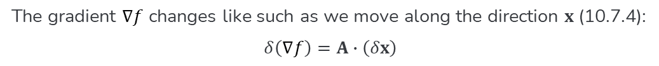
Defining Formally
The gradient $∇f$ changes like such as we move along the direction $x$ (10.7.4):
$$δ\left(∇f\right)=A∙\left(δx\right)$$

Slide 17
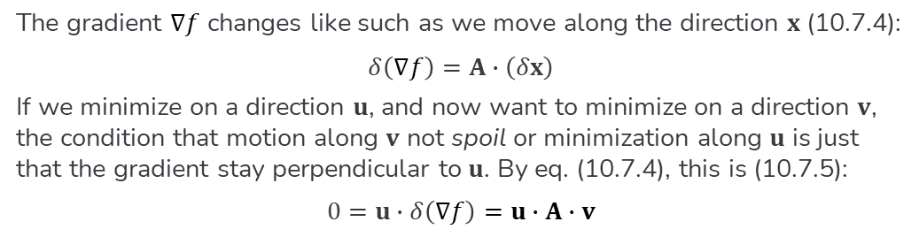
Defining Formally
The gradient $∇f$ changes like such as we move along the direction $x$ (10.7.4):
$$δ\left(∇f\right)=A∙\left(δx\right)$$
If we minimize on a direction $u$, and now want to minimize on a direction $v$, the condition that motion along $v$ not spoil or minimization along $u$ is just that the gradient stay perpendicular to $u$. By eq. (10.7.4), this is (10.7.5):
$$0=u∙δ\left(∇f\right)=u∙A∙v$$

Slide 18
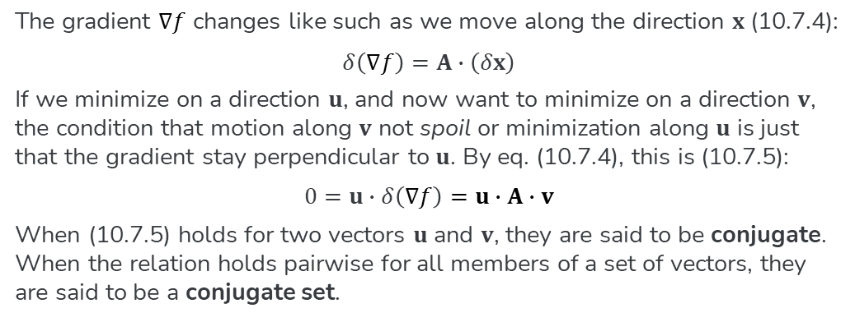
Defining Formally
The gradient $∇f$ changes like such as we move along the direction $x$ (10.7.4):
$$δ\left(∇f\right)=A∙\left(δx\right)$$
If we minimize on a direction $u$, and now want to minimize on a direction $v$, the condition that motion along $v$ not spoil or minimization along $u$ is just that the gradient stay perpendicular to $u$. By eq. (10.7.4), this is (10.7.5):
$$0=u∙δ\left(∇f\right)=u∙A∙v$$
When (10.7.5) holds for two vectors $u$ and $v$, they are said to be conjugate. When the relation holds pairwise for all members of a set of vectors, they are said to be a conjugate set.

Slide 19
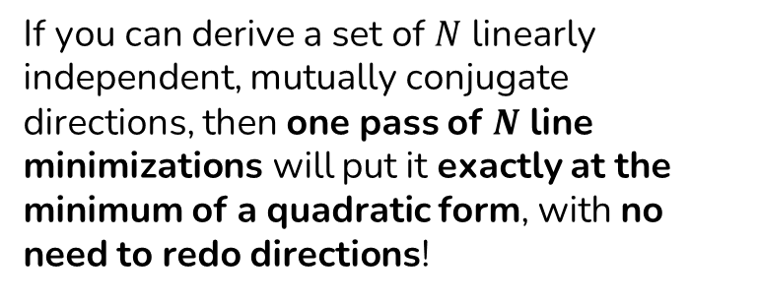
If you can derive a set of $N$ linearly independent, mutually conjugate directions, then one pass of $N$ line minimizations will put it exactly at the minimum of a quadratic form, with no need to redo directions!
From section 10.7.1

Slide 20
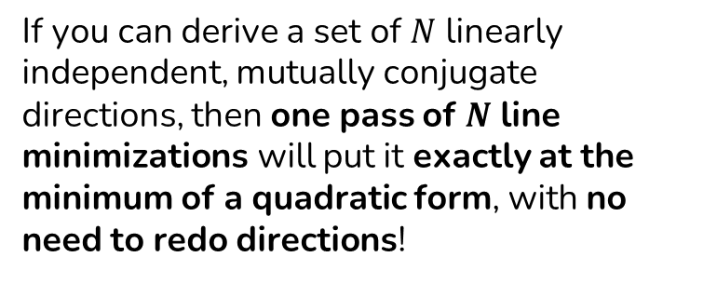
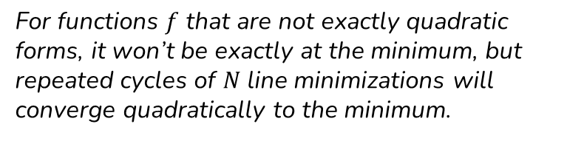
If you can derive a set of $N$ linearly independent, mutually conjugate directions, then one pass of $N$ line minimizations will put it exactly at the minimum of a quadratic form, with no need to redo directions!
For functions $f$ that are not exactly quadratic forms, it won’t be exactly at the minimum, but repeated cycles of $N$ line minimizations will converge quadratically to the minimum.
From section 10.7.1

Slide 21
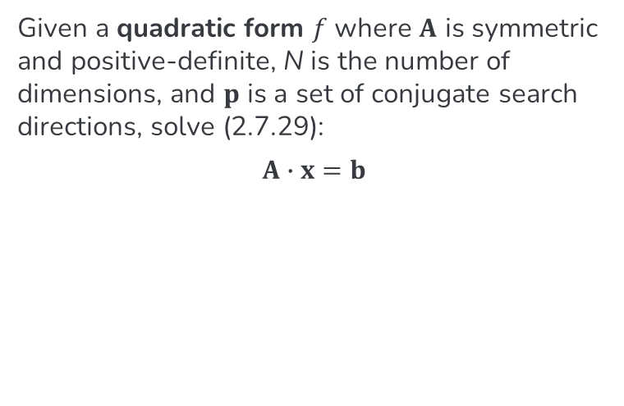
Simple Conjugate Gradient (CG)
Given a quadratic form $f$ where $A$ is symmetric and positive-definite, N is the number of dimensions, and $p$ is a set of conjugate search directions, solve (2.7.29):
$$A∙x=b$$
From section 2.7.6

Slide 22
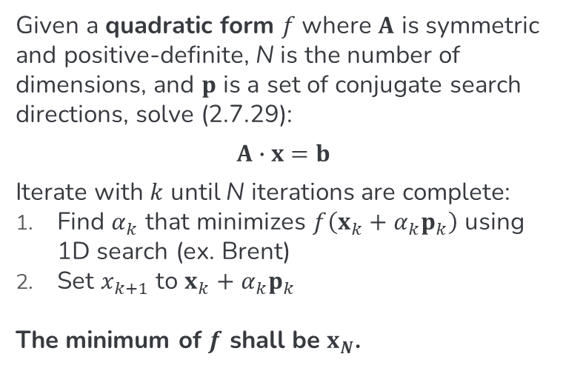
Simple Conjugate Gradient (CG)
Given a quadratic form $f$ where $A$ is symmetric and positive-definite, N is the number of dimensions, and $p$ is a set of conjugate search directions, solve (2.7.29):
$$A∙x=b$$
Iterate with $k$ until N iterations are complete:
Find $α_{k}$ that minimizes $f\left(x_{k}+α_{k}p_{k}\right)$ using 1D search (ex. Brent)
Set $x_{k+1}$ to $x_{k}+α_{k}p_{k}$
The minimum of $f$ shall be $x_{N}$.
From section 2.7.6

Slide 23
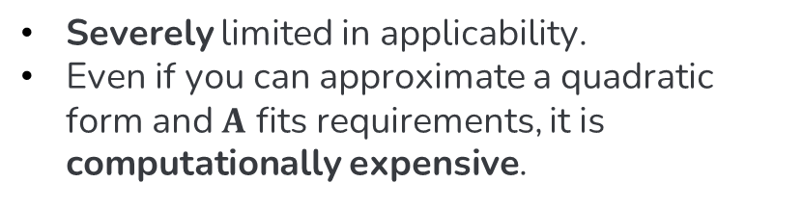
Problems with Simple CG
Severely limited in applicability.
Even if you can approximate a quadratic form and $A$ fits requirements, it is computationally expensive.

Slide 24
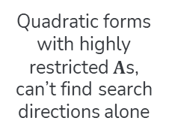
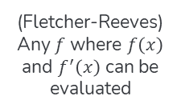
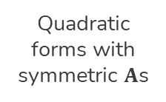
Expanding CG
Linear CG
Polak-Ribiere
Quadratic forms with symmetric $A$s
Superior convergence to Fletcher-Reeves
Simple CG
Nonlinear CG
Quadratic forms with highly restricted $A$s, can’t find search directions alone
(Fletcher-Reeves)
Any $f$ where $f\left(x\right)$ and $f^{′}\left(x\right)$ can be evaluated

Slide 25
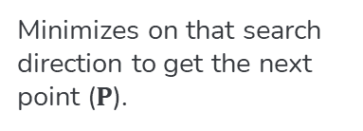
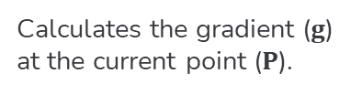

Linear CG
01
Gradient
02
Search Direction
03
Next Point
04
Repeat
Calculates the gradient ($g$) at the current point ($P$).
Uses the gradient to find the next conjugate search direction ($h$)
Minimizes on that search direction to get the next point ($P$).
Performs as many iterations as the number of dimensions.

Slide 26
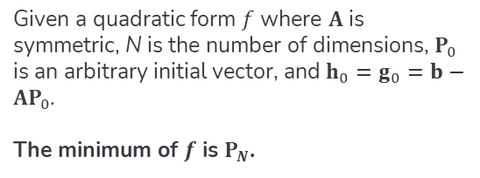
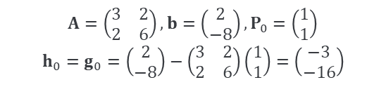
Linear CG
Theory (10.8)
Example
Given a quadratic form $f$ where $A$ is symmetric, N is the number of dimensions, $P_{0}$ is an arbitrary initial vector, and $h_{0}=g_{0}=b−AP_{0}$.
The minimum of $f$ is $P_{N}$.
$$A=\left(\begin{matrix}3 & 2 \\ 2 & 6\end{matrix}\right),b=\left(\begin{matrix}2 \\ −8\end{matrix}\right),P_{0}=\left(\begin{matrix}1 \\ 1\end{matrix}\right)$$
$$h_{0}=g_{0}=\left(\begin{matrix}2 \\ −8\end{matrix}\right)−\left(\begin{matrix}3 & 2 \\ 2 & 6\end{matrix}\right)\left(\begin{matrix}1 \\ 1\end{matrix}\right)=\left(\begin{matrix}−3 \\ −16\end{matrix}\right)$$

Slide 27
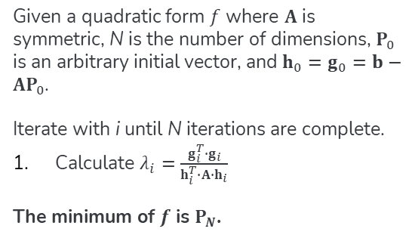
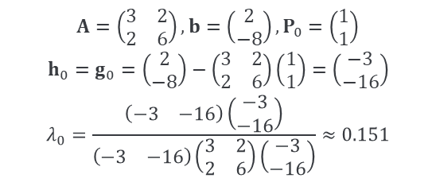
Linear CG
Theory (10.8)
Example
Given a quadratic form $f$ where $A$ is symmetric, N is the number of dimensions, $P_{0}$ is an arbitrary initial vector, and $h_{0}=g_{0}=b−AP_{0}$.
Iterate with i until N iterations are complete.
Calculate $λ_{i}=\frac{g_{i}^{T}∙g_{i}}{h_{i}^{T}∙A∙h_{i}}$
The minimum of $f$ is $P_{N}$.
$$A=\left(\begin{matrix}3 & 2 \\ 2 & 6\end{matrix}\right),b=\left(\begin{matrix}2 \\ −8\end{matrix}\right),P_{0}=\left(\begin{matrix}1 \\ 1\end{matrix}\right)$$
$$h_{0}=g_{0}=\left(\begin{matrix}2 \\ −8\end{matrix}\right)−\left(\begin{matrix}3 & 2 \\ 2 & 6\end{matrix}\right)\left(\begin{matrix}1 \\ 1\end{matrix}\right)=\left(\begin{matrix}−3 \\ −16\end{matrix}\right)$$
$$λ_{0}=\frac{\left(\begin{matrix}−3 & −16\end{matrix}\right)\left(\begin{matrix}−3 \\ −16\end{matrix}\right)}{\left(\begin{matrix}−3 & −16\end{matrix}\right)\left(\begin{matrix}3 & 2 \\ 2 & 6\end{matrix}\right)\left(\begin{matrix}−3 \\ −16\end{matrix}\right)}≈0.151$$

Slide 28
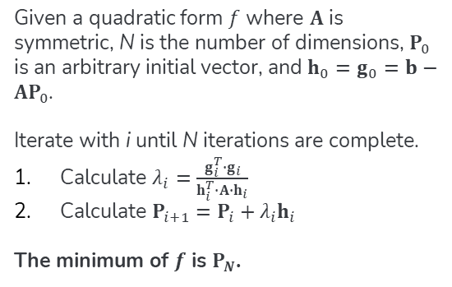
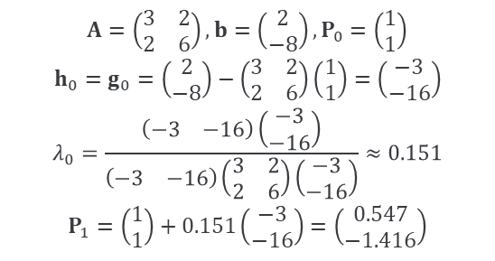
Linear CG
Theory (10.8)
Example
Given a quadratic form $f$ where $A$ is symmetric, N is the number of dimensions, $P_{0}$ is an arbitrary initial vector, and $h_{0}=g_{0}=b−AP_{0}$.
Iterate with i until N iterations are complete.
Calculate $λ_{i}=\frac{g_{i}^{T}∙g_{i}}{h_{i}^{T}∙A∙h_{i}}$
Calculate $P_{i+1}=P_{i}+λ_{i}h_{i}$
The minimum of $f$ is $P_{N}$.
$$A=\left(\begin{matrix}3 & 2 \\ 2 & 6\end{matrix}\right),b=\left(\begin{matrix}2 \\ −8\end{matrix}\right),P_{0}=\left(\begin{matrix}1 \\ 1\end{matrix}\right)$$
$$h_{0}=g_{0}=\left(\begin{matrix}2 \\ −8\end{matrix}\right)−\left(\begin{matrix}3 & 2 \\ 2 & 6\end{matrix}\right)\left(\begin{matrix}1 \\ 1\end{matrix}\right)=\left(\begin{matrix}−3 \\ −16\end{matrix}\right)$$
$$λ_{0}=\frac{\left(\begin{matrix}−3 & −16\end{matrix}\right)\left(\begin{matrix}−3 \\ −16\end{matrix}\right)}{\left(\begin{matrix}−3 & −16\end{matrix}\right)\left(\begin{matrix}3 & 2 \\ 2 & 6\end{matrix}\right)\left(\begin{matrix}−3 \\ −16\end{matrix}\right)}≈0.151$$
$$P_{1}=\left(\begin{matrix}1 \\ 1\end{matrix}\right)+0.151\left(\begin{matrix}−3 \\ −16\end{matrix}\right)=\left(\begin{matrix}0.547 \\ −1.416\end{matrix}\right)$$

Slide 29
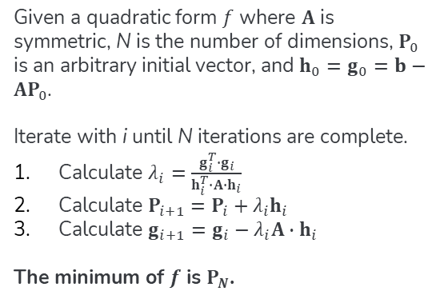
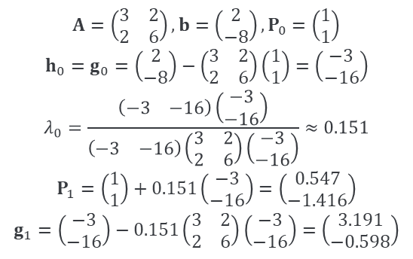
Linear CG
Theory (10.8)
Example
Given a quadratic form $f$ where $A$ is symmetric, N is the number of dimensions, $P_{0}$ is an arbitrary initial vector, and $h_{0}=g_{0}=b−AP_{0}$.
Iterate with i until N iterations are complete.
Calculate $λ_{i}=\frac{g_{i}^{T}∙g_{i}}{h_{i}^{T}∙A∙h_{i}}$
Calculate $P_{i+1}=P_{i}+λ_{i}h_{i}$
Calculate $g_{i+1}=g_{i}−λ_{i}A∙h_{i}$
The minimum of $f$ is $P_{N}$.
$$A=\left(\begin{matrix}3 & 2 \\ 2 & 6\end{matrix}\right),b=\left(\begin{matrix}2 \\ −8\end{matrix}\right),P_{0}=\left(\begin{matrix}1 \\ 1\end{matrix}\right)$$
$$h_{0}=g_{0}=\left(\begin{matrix}2 \\ −8\end{matrix}\right)−\left(\begin{matrix}3 & 2 \\ 2 & 6\end{matrix}\right)\left(\begin{matrix}1 \\ 1\end{matrix}\right)=\left(\begin{matrix}−3 \\ −16\end{matrix}\right)$$
$$λ_{0}=\frac{\left(\begin{matrix}−3 & −16\end{matrix}\right)\left(\begin{matrix}−3 \\ −16\end{matrix}\right)}{\left(\begin{matrix}−3 & −16\end{matrix}\right)\left(\begin{matrix}3 & 2 \\ 2 & 6\end{matrix}\right)\left(\begin{matrix}−3 \\ −16\end{matrix}\right)}≈0.151$$
$$P_{1}=\left(\begin{matrix}1 \\ 1\end{matrix}\right)+0.151\left(\begin{matrix}−3 \\ −16\end{matrix}\right)=\left(\begin{matrix}0.547 \\ −1.416\end{matrix}\right)$$
$$g_{1}=\left(\begin{matrix}−3 \\ −16\end{matrix}\right)−0.151\left(\begin{matrix}3 & 2 \\ 2 & 6\end{matrix}\right)\left(\begin{matrix}−3 \\ −16\end{matrix}\right)=\left(\begin{matrix}3.191 \\ −0.598\end{matrix}\right)$$

Slide 30
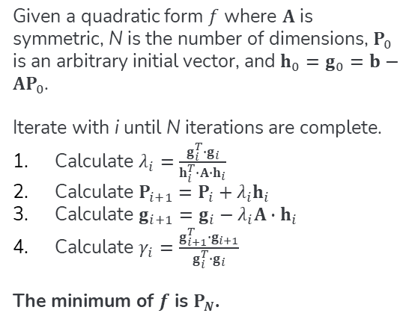
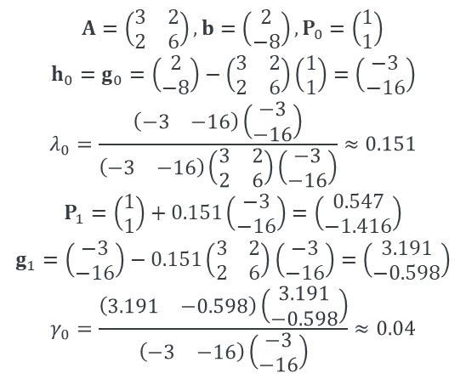
Linear CG
Theory (10.8)
Example
Given a quadratic form $f$ where $A$ is symmetric, N is the number of dimensions, $P_{0}$ is an arbitrary initial vector, and $h_{0}=g_{0}=b−AP_{0}$.
Iterate with i until N iterations are complete.
Calculate $λ_{i}=\frac{g_{i}^{T}∙g_{i}}{h_{i}^{T}∙A∙h_{i}}$
Calculate $P_{i+1}=P_{i}+λ_{i}h_{i}$
Calculate $g_{i+1}=g_{i}−λ_{i}A∙h_{i}$
Calculate $γ_{i}=\frac{g_{i+1}^{T}∙g_{i+1}}{g_{i}^{T}∙g_{i}}$
The minimum of $f$ is $P_{N}$.
$$A=\left(\begin{matrix}3 & 2 \\ 2 & 6\end{matrix}\right),b=\left(\begin{matrix}2 \\ −8\end{matrix}\right),P_{0}=\left(\begin{matrix}1 \\ 1\end{matrix}\right)$$
$$h_{0}=g_{0}=\left(\begin{matrix}2 \\ −8\end{matrix}\right)−\left(\begin{matrix}3 & 2 \\ 2 & 6\end{matrix}\right)\left(\begin{matrix}1 \\ 1\end{matrix}\right)=\left(\begin{matrix}−3 \\ −16\end{matrix}\right)$$
$$λ_{0}=\frac{\left(\begin{matrix}−3 & −16\end{matrix}\right)\left(\begin{matrix}−3 \\ −16\end{matrix}\right)}{\left(\begin{matrix}−3 & −16\end{matrix}\right)\left(\begin{matrix}3 & 2 \\ 2 & 6\end{matrix}\right)\left(\begin{matrix}−3 \\ −16\end{matrix}\right)}≈0.151$$
$$P_{1}=\left(\begin{matrix}1 \\ 1\end{matrix}\right)+0.151\left(\begin{matrix}−3 \\ −16\end{matrix}\right)=\left(\begin{matrix}0.547 \\ −1.416\end{matrix}\right)$$
$$g_{1}=\left(\begin{matrix}−3 \\ −16\end{matrix}\right)−0.151\left(\begin{matrix}3 & 2 \\ 2 & 6\end{matrix}\right)\left(\begin{matrix}−3 \\ −16\end{matrix}\right)=\left(\begin{matrix}3.191 \\ −0.598\end{matrix}\right)$$
$$γ_{0}=\frac{\left(\begin{matrix}3.191 & −0.598\end{matrix}\right)\left(\begin{matrix}3.191 \\ −0.598\end{matrix}\right)}{\left(\begin{matrix}−3 & −16\end{matrix}\right)\left(\begin{matrix}−3 \\ −16\end{matrix}\right)}≈0.04$$

Slide 31
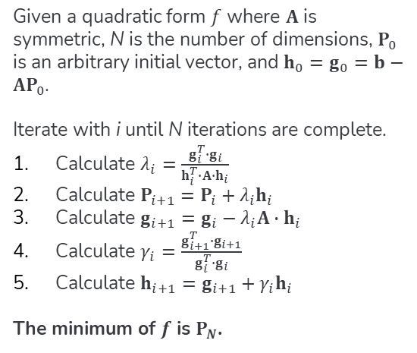
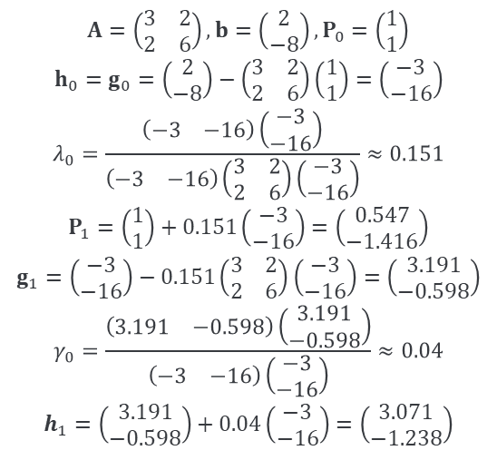
Linear CG
Theory (10.8)
Example
Given a quadratic form $f$ where $A$ is symmetric, N is the number of dimensions, $P_{0}$ is an arbitrary initial vector, and $h_{0}=g_{0}=b−AP_{0}$.
Iterate with i until N iterations are complete.
Calculate $λ_{i}=\frac{g_{i}^{T}∙g_{i}}{h_{i}^{T}∙A∙h_{i}}$
Calculate $P_{i+1}=P_{i}+λ_{i}h_{i}$
Calculate $g_{i+1}=g_{i}−λ_{i}A∙h_{i}$
Calculate $γ_{i}=\frac{g_{i+1}^{T}∙g_{i+1}}{g_{i}^{T}∙g_{i}}$
Calculate $h_{i+1}=g_{i+1}+γ_{i}h_{i}$
The minimum of $f$ is $P_{N}$.
$$A=\left(\begin{matrix}3 & 2 \\ 2 & 6\end{matrix}\right),b=\left(\begin{matrix}2 \\ −8\end{matrix}\right),P_{0}=\left(\begin{matrix}1 \\ 1\end{matrix}\right)$$
$$h_{0}=g_{0}=\left(\begin{matrix}2 \\ −8\end{matrix}\right)−\left(\begin{matrix}3 & 2 \\ 2 & 6\end{matrix}\right)\left(\begin{matrix}1 \\ 1\end{matrix}\right)=\left(\begin{matrix}−3 \\ −16\end{matrix}\right)$$
$$λ_{0}=\frac{\left(\begin{matrix}−3 & −16\end{matrix}\right)\left(\begin{matrix}−3 \\ −16\end{matrix}\right)}{\left(\begin{matrix}−3 & −16\end{matrix}\right)\left(\begin{matrix}3 & 2 \\ 2 & 6\end{matrix}\right)\left(\begin{matrix}−3 \\ −16\end{matrix}\right)}≈0.151$$
$$P_{1}=\left(\begin{matrix}1 \\ 1\end{matrix}\right)+0.151\left(\begin{matrix}−3 \\ −16\end{matrix}\right)=\left(\begin{matrix}0.547 \\ −1.416\end{matrix}\right)$$
$$g_{1}=\left(\begin{matrix}−3 \\ −16\end{matrix}\right)−0.151\left(\begin{matrix}3 & 2 \\ 2 & 6\end{matrix}\right)\left(\begin{matrix}−3 \\ −16\end{matrix}\right)=\left(\begin{matrix}3.191 \\ −0.598\end{matrix}\right)$$
$$γ_{0}=\frac{\left(\begin{matrix}3.191 & −0.598\end{matrix}\right)\left(\begin{matrix}3.191 \\ −0.598\end{matrix}\right)}{\left(\begin{matrix}−3 & −16\end{matrix}\right)\left(\begin{matrix}−3 \\ −16\end{matrix}\right)}≈0.04$$
$$h_{1}=\left(\begin{matrix}3.191 \\ −0.598\end{matrix}\right)+0.04\left(\begin{matrix}−3 \\ −16\end{matrix}\right)=\left(\begin{matrix}3.071 \\ −1.238\end{matrix}\right)$$

Slide 32
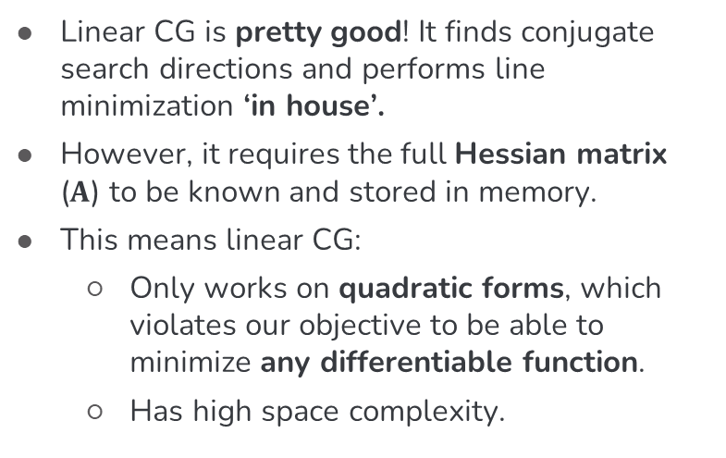
Beyond Linearity
Linear CG is pretty good! It finds conjugate search directions and performs line minimization ‘in house’.
However, it requires the full Hessian matrix ($A$) to be known and stored in memory.
This means linear CG:
Only works on quadratic forms, which violates our objective to be able to minimize any differentiable function.
Has high space complexity.

Slide 33
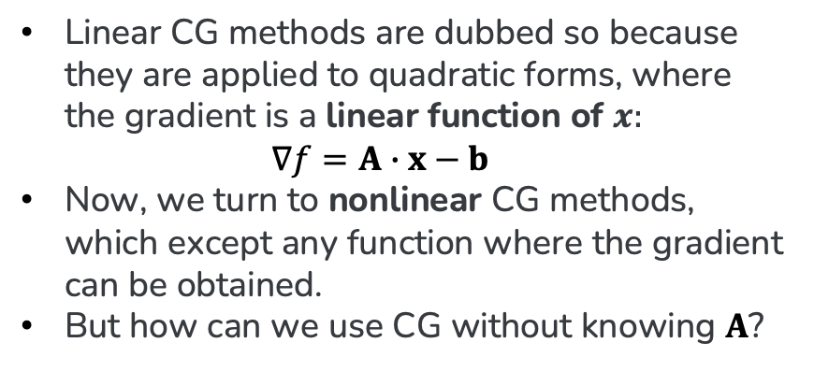
How so Linearity?
Linear CG methods are dubbed so because they are applied to quadratic forms, where the gradient is a linear function of $x:$ $∇f=A∙x−b$
Now, we turn to nonlinear CG methods, which except any function where the gradient can be obtained.
But how can we use CG without knowing $A$?

Slide 34

We only need 4 changes to drop $A$ entirely.
What if I told you…

Slide 35
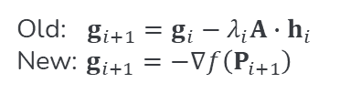
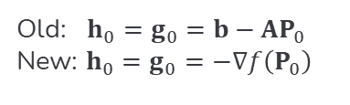
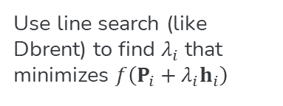
Fletcher-Reeves Nonlinear CG
01
Initialization
02
Line Search
03
Gradient Calculation
04
Lifecycle
Old: $h_{0}=g_{0}=b−AP_{0}$
New: $h_{0}=g_{0}=−∇f\left(P_{0}\right)$
Use line search (like Dbrent) to find $λ_{i}$ that minimizes $f\left(P_{i}+λ_{i}h_{i}\right)$
Old: $g_{i+1}=g_{i}−λ_{i}A∙h_{i}$
New: $g_{i+1}=$ $−∇f\left(P_{i+1}\right)$
Minimization stops at convergence instead of N iterations.

Slide 36
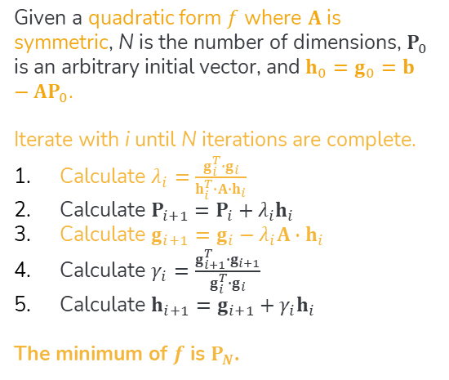
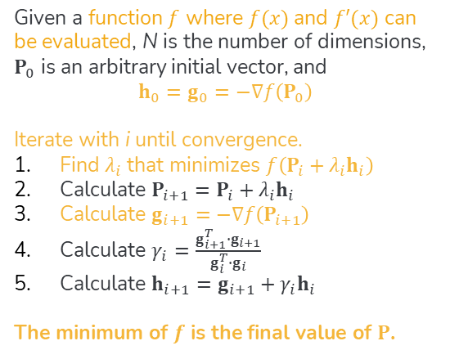
Compare & Contrast
Linear
Nonlinear
Given a quadratic form $f$ where $A$ is symmetric, N is the number of dimensions, $P_{0}$ is an arbitrary initial vector, and $h_{0}=g_{0}=b−AP_{0}$.
Iterate with i until N iterations are complete.
Calculate $λ_{i}=\frac{g_{i}^{T}∙g_{i}}{h_{i}^{T}∙A∙h_{i}}$
Calculate $P_{i+1}=P_{i}+λ_{i}h_{i}$
Calculate $g_{i+1}=g_{i}−λ_{i}A∙h_{i}$
Calculate $γ_{i}=\frac{g_{i+1}^{T}∙g_{i+1}}{g_{i}^{T}∙g_{i}}$
Calculate $h_{i+1}=g_{i+1}+γ_{i}h_{i}$
The minimum of $f$ is $P_{N}$.
Given a function $f$ where $f(x)$ and $f′(x)$ can be evaluated, N is the number of dimensions, $P_{0}$ is an arbitrary initial vector, and
$$h_{0}=g_{0}=−∇f\left(P_{0}\right)$$
Iterate with i until convergence.
Find $λ_{i}$ that minimizes $f\left(P_{i}+λ_{i}h_{i}\right)$
Calculate $P_{i+1}=P_{i}+λ_{i}h_{i}$
Calculate $g_{i+1}=$ $−∇f\left(P_{i+1}\right)$
Calculate $γ_{i}=\frac{g_{i+1}^{T}∙g_{i+1}}{g_{i}^{T}∙g_{i}}$
Calculate $h_{i+1}=g_{i+1}+γ_{i}h_{i}$
The minimum of $f$ is the final value of $P$.

Slide 37
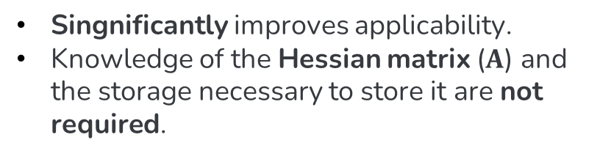
Benefits of Fletcher-Reeves
Singnificantly improves applicability.
Knowledge of the Hessian matrix ($A$) and the storage necessary to store it are not required.

Slide 38
It can converge even faster.
But what if I told you…

Slide 39
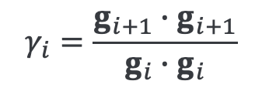
Polak-Ribiere
A one-line code change (literally) can make
Fletcher-Reeves converge even faster on
non-quadratic form functions.
$$γ_{i}=\frac{g_{i+1}∙g_{i+1}}{g_{i}∙g_{i}}$$

Slide 40
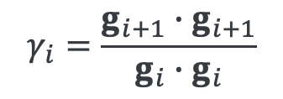
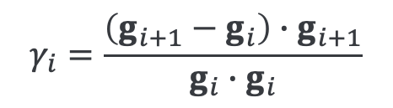
Polak-Ribiere
A one-line code change (literally) can make
Fletcher-Reeves converge even faster on
non-quadratic form functions.
$$γ_{i}=\frac{g_{i+1}∙g_{i+1}}{g_{i}∙g_{i}}$$
$$γ_{i}=\frac{\left(g_{i+1}−g_{i}\right)∙g_{i+1}}{g_{i}∙g_{i}}$$

Slide 41
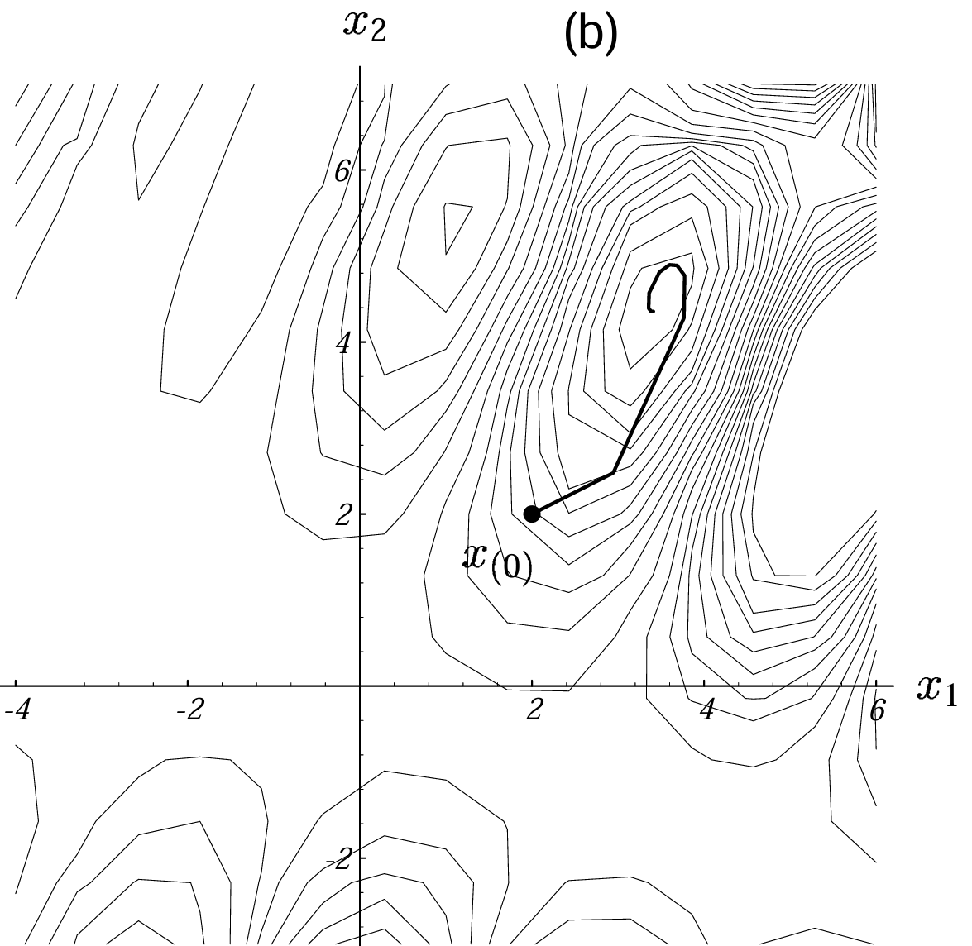

Convergence, Visualized
Fletcher-Reeves
Polak-Ribiere

Slide 42
Quasi-Newton Methods
But what if I told you there’s a last frontier of CG expansion…

Slide 43
Thanks!
Until then…
Joshua Sheldon
jsheldon2022@my.fit.edu

Slide 44
Additional Resources
Nonlinear conjugate gradient method (Wikipedia)
An Introduction to the Conjugate Gradient Method Without the Agonizing Pain (Edition 1¼)
Introduction to Mathematical Optimization with Python (Chapter 5: Conjugate Gradient Methods)
Taylor series (Wikipedia)
Taylor series | Chapter 11, Essence of calculus (3Blue1Brown)

